Slide 1
Intermolecular Forces
Of differing strengths
§14.3

Slide 2
Dipole-Dipole Attraction (Keesom)
Dipolar molecules can adopt attractive orientations
:N≡C–H
H–C≡N:
H–C≡N:
H–C≡N:
H–C≡N:
H–C≡N:

Slide 3
Dipole-Dipole Attraction
Much weaker than covalent bonds
Unimportant in gas phase

Slide 4
London Dispersion Forces
Even non-polar electron orbitals are only nonpolar on average over time
Any electron-nucleus pair is a constantly fluctuating dipole
Electrons correlate their motion to produce a weak attraction
Very weak, but attractive

Slide 5
Dipole-Induced Dipole (Debye)
Polarizable electron cloud distorts in response to an external field, such as from a dipole
Weak, but not as weak as London forces

Slide 6
van der Waals forces
Catch-all term for London, Keesom, Debye, and related forces
Weak, short-range forces

Slide 7
Hydrogen Bonding

Slide 8
Hydrogen Bonds
Intermolecular attraction between an H atom bonded to an electronegative atom and a non-bonding electron pair on an electronegative atom
H
••
O
••
H
••
N
H
H
H

Slide 9
Attraction
Strong dipole-dipole attraction
Partial + charge at H
Partial − charge at lone pair
Possible covalent character
Allows electron delocalization

Slide 10
Donors and Acceptors
H-bond donor: molecule with the H
Water H–O–H
Alcohols R₃C–O–H †
Carboxylic acids –C(O) –O –H
H-bond acceptor: molecule with the electron pair
Primarily N, O, F
† R = C or H

Slide 11
Significance
Boiling Temperatures, celsius
CH₄: −161.6 | NH₃: −33.6 | H₂O: 100 | HF: 19.5
SiH₄: −111.7 | PH₃: −87.7 | H₂S: −60.0 | HCl: −85.1

Slide 12
H Bonding in Water
A water molecule has 2 H bond donor sites and 2 H bond acceptor sites
Strong connections between molecules in condensed phase
Interactive structure https://www.biotopics.co.uk/jsmol/ice.html

Slide 13
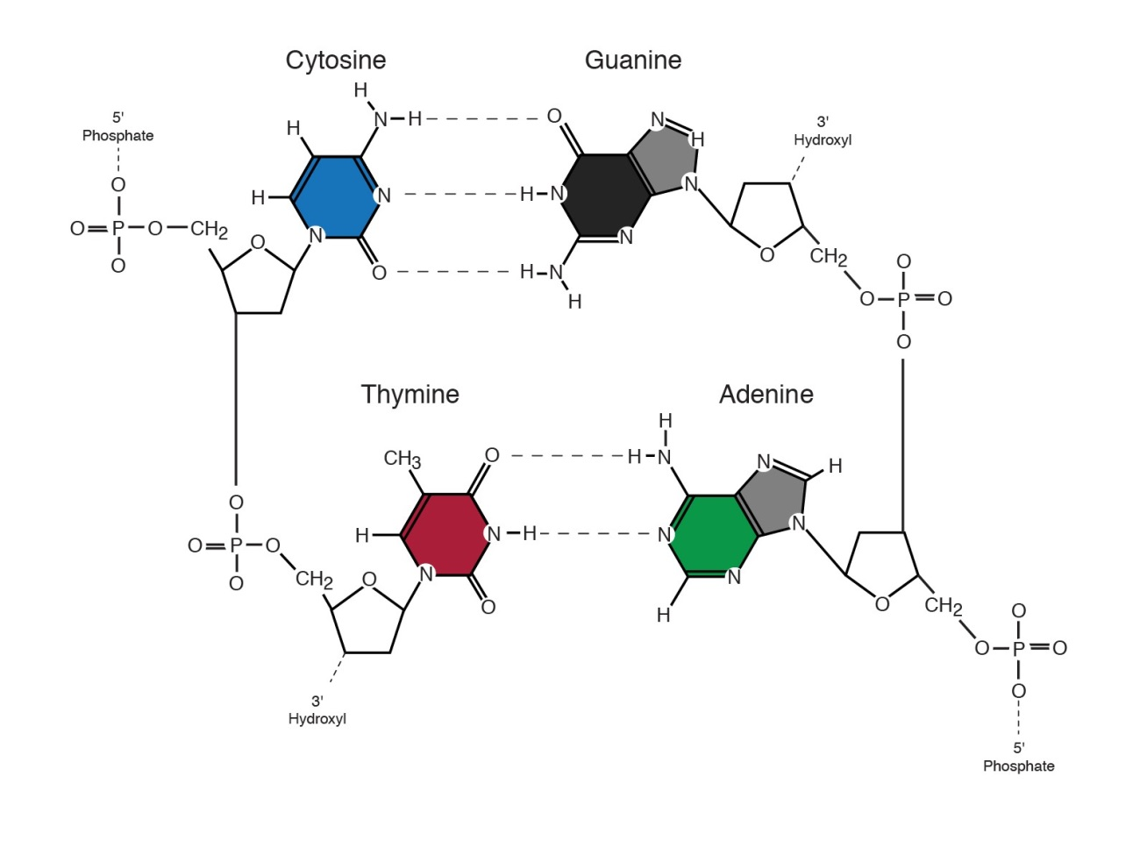
Significance
H bonding secures the 3-D structures of many biomolecules
Source: National Human Genome Research Institute

Slide 14
Classes of Solids
Crystalline
Glassy

Slide 15
Crystalline Solids
Ionic
Hard, high-melting and boiling
Metallic
Conductive, lustrous, malleable and ductile
Molecular
Low-melting
Network
Hard

